Slide 1
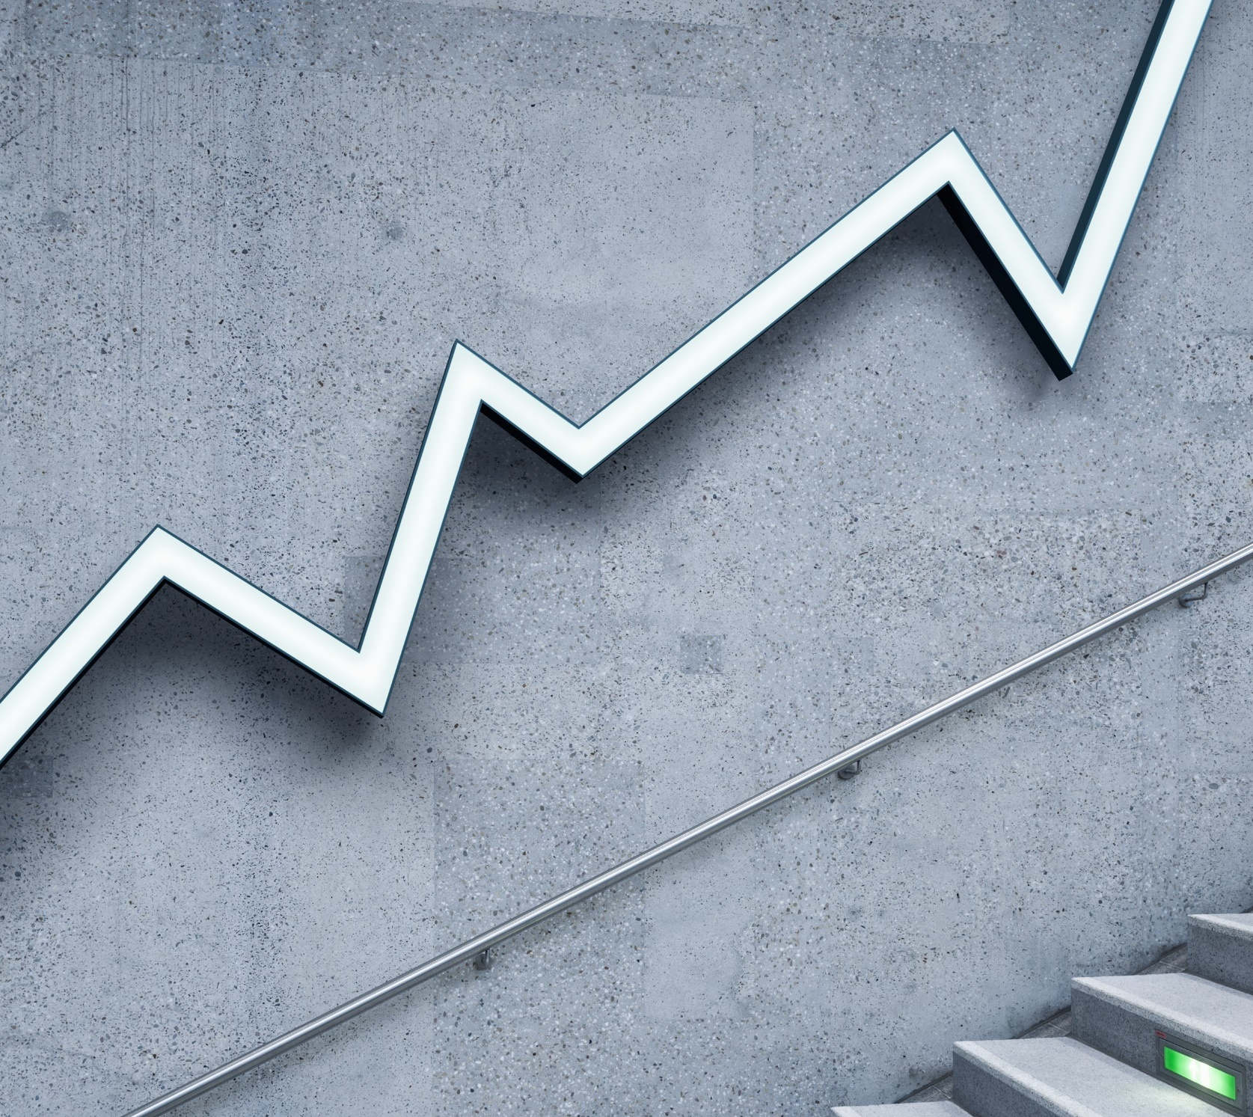
Twitter Data Analysis
Team Skyler, heydan, xia and vani

Slide 2
Group 5 Project 2 Questions to Answer The principal focus is to understand the impact Twitter has on the financial market, specifically cryptocurrencies. Different trends amongst the most popular crypto assets are analyzed and underlying correlations are determined. Specific attention is paid to high profile figures joining in on the crypto tweeting action, and the impact they have on the trends overall. To-DO
pitch

Slide 3
Questions
When Dogecoin is trending on Twitter, is Bitcoin also trending; if so, how correlated are they? If not, what is their relationship?
When a high-profile public figure tweets about a certain crypto, such as Elon Musk with Dogecoin, what is the impact on its stock value? (he tweets about it a lot)
How often are public figure tweets about crypto retweeted relative to other tweets? Technology
How do other ‘meme-stocks’ such as $GME & $AMC compare with $DOGE? What languages do most people use to talk about meme stocks?
What time of day is relatively most popular in regards to these crypto assets?

Slide 4
Todo
Develop code to gather relevant data Format Twitter data into queryable datasets using Spark Query the data to narrow it down into the pieces that pertain to our questions Analyze our results and formulate our answers from them Summarize answers into a presentation format Create the presentation

Slide 5
Technologies
Apache Spark 2.4.7 Spark SQL YARN AWS HDFS and/or S3 Scala 2.11.12 Git + GitHub Twitter API VS Code

Slide 6
Q1 Dogecoin Trend analysis
When Dogecoin is trending on Twitter, is Bitcoin also trending; if so, how correlated are they? If not, what is their relationship?

Slide 7
. Public figure influence on Crypto
Q2. When a high-profile public figure tweets about a certain crypto, such as Elon Musk with Dogecoin, what is the impact on its stock value? (he tweets about it a lot)

Slide 8
Retweet Counts
Q3.How often are public figure tweets about crypto retweeted relative to other tweets? Technology

Slide 10
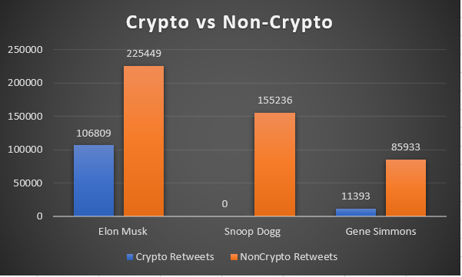

Slide 11
‘meme-stocks’
Q4.How do other ‘meme-stocks’ such as $GME & $AMC compare with $DOGE? What languages do most people use to talk about meme stocks?

Slide 12
Most Active Hours
Q5.What time of day is relatively most popular in regard to these crypto assets?

Slide 13
